Slide 1
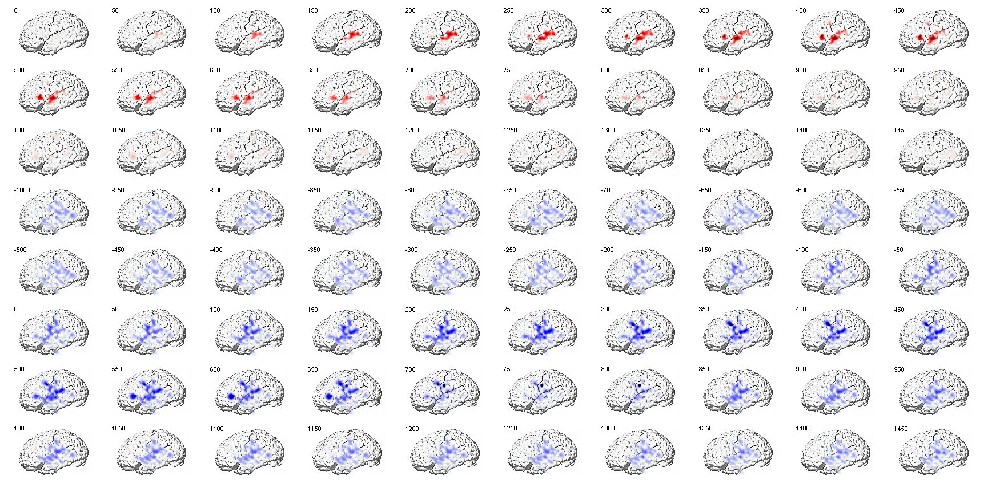
1
Perc
Prod
Activation zscore around word onset during perception and production. Number is time in ms around event. Intervals of 50 ms

Slide 2
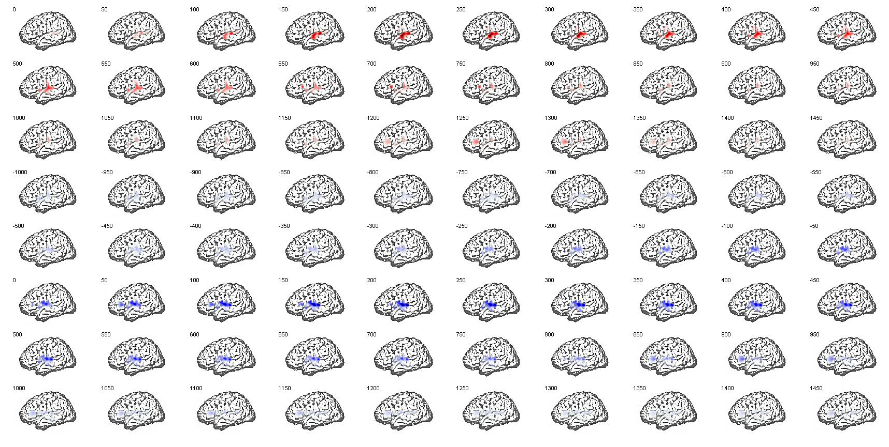
2
Perc
Prod

Slide 3
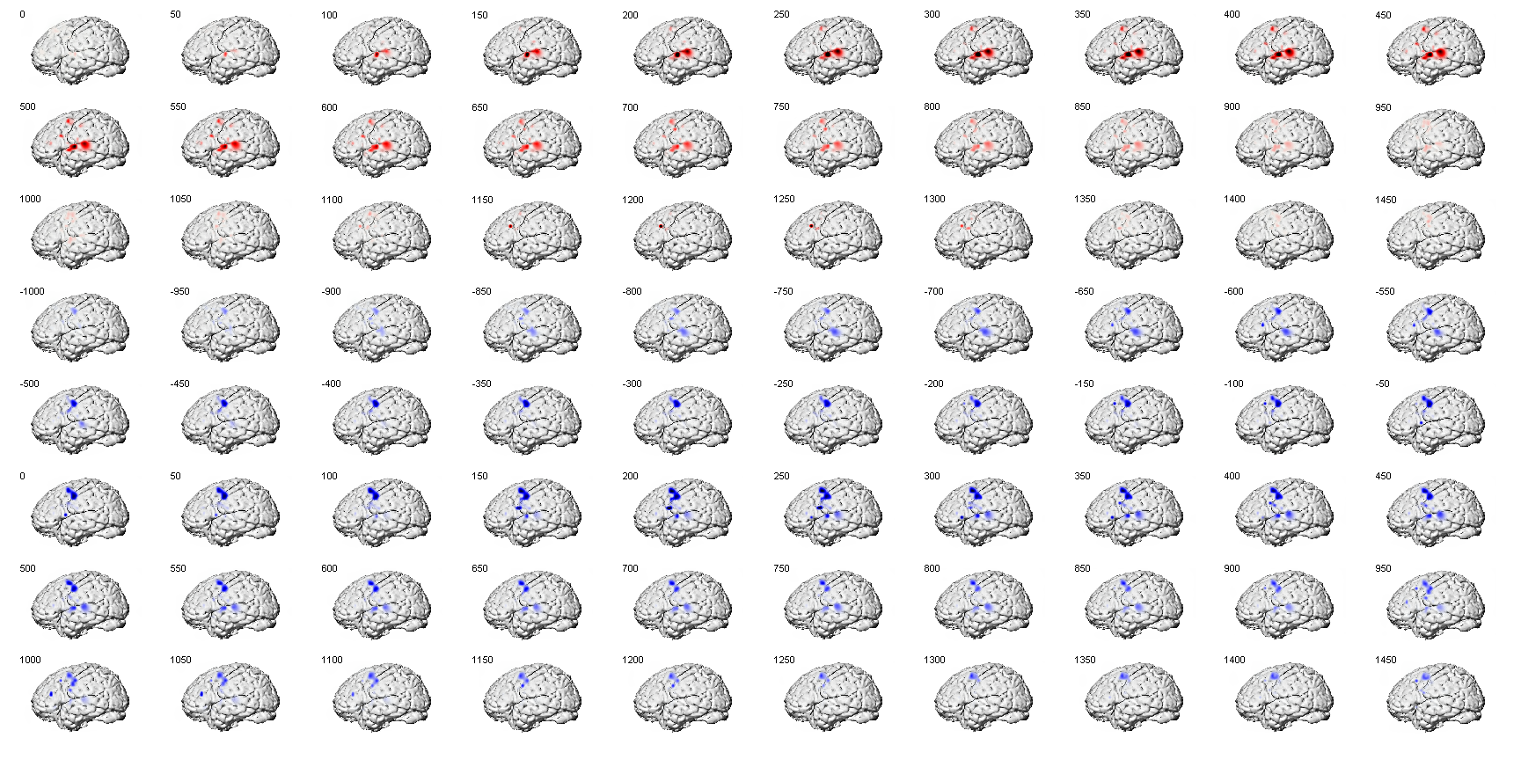
3
Perc
Prod

Slide 4
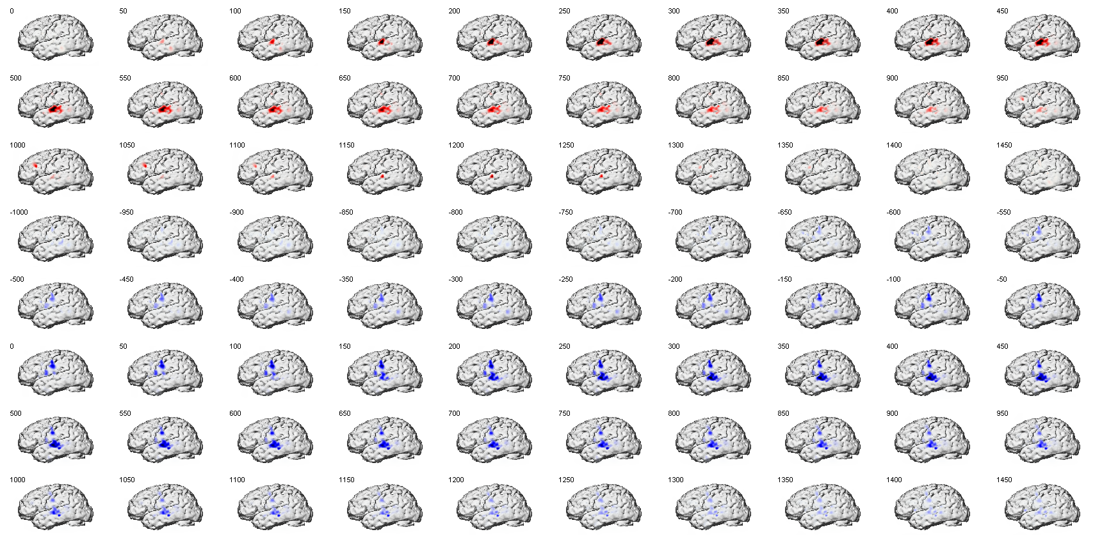
4
Perc
Prod

Slide 5
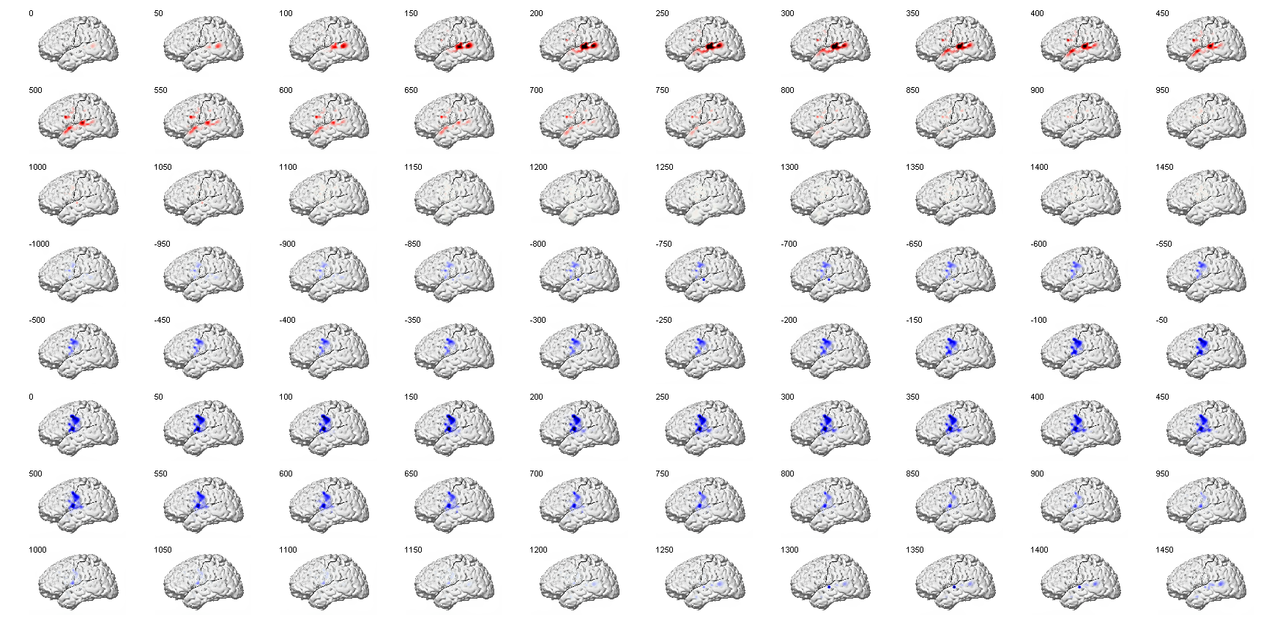
5
Perc
Prod

Slide 6
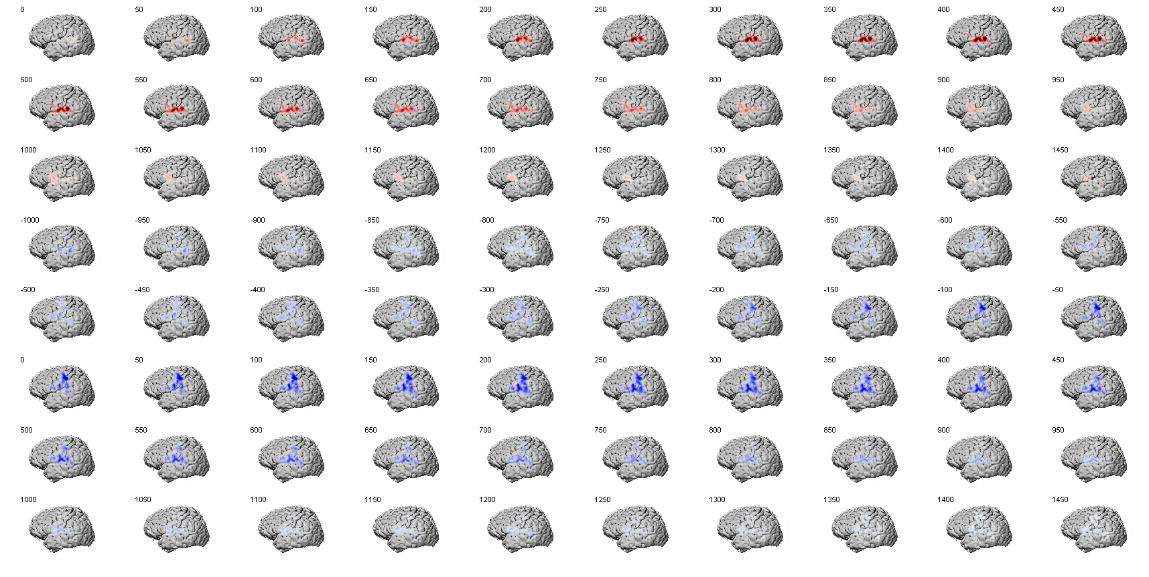
6
Perc
Prod

Slide 7
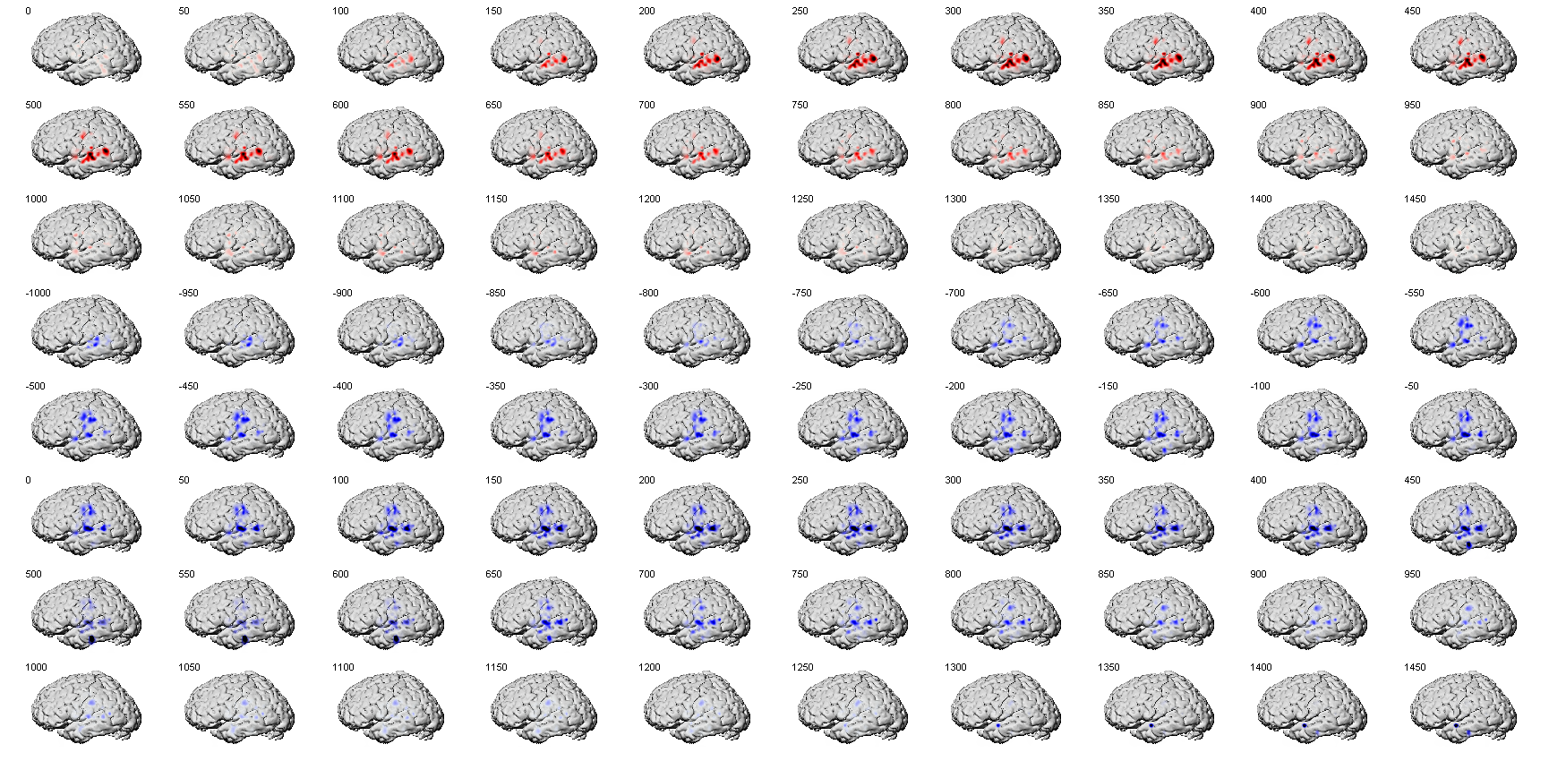
7
Perc
Prod

Slide 8
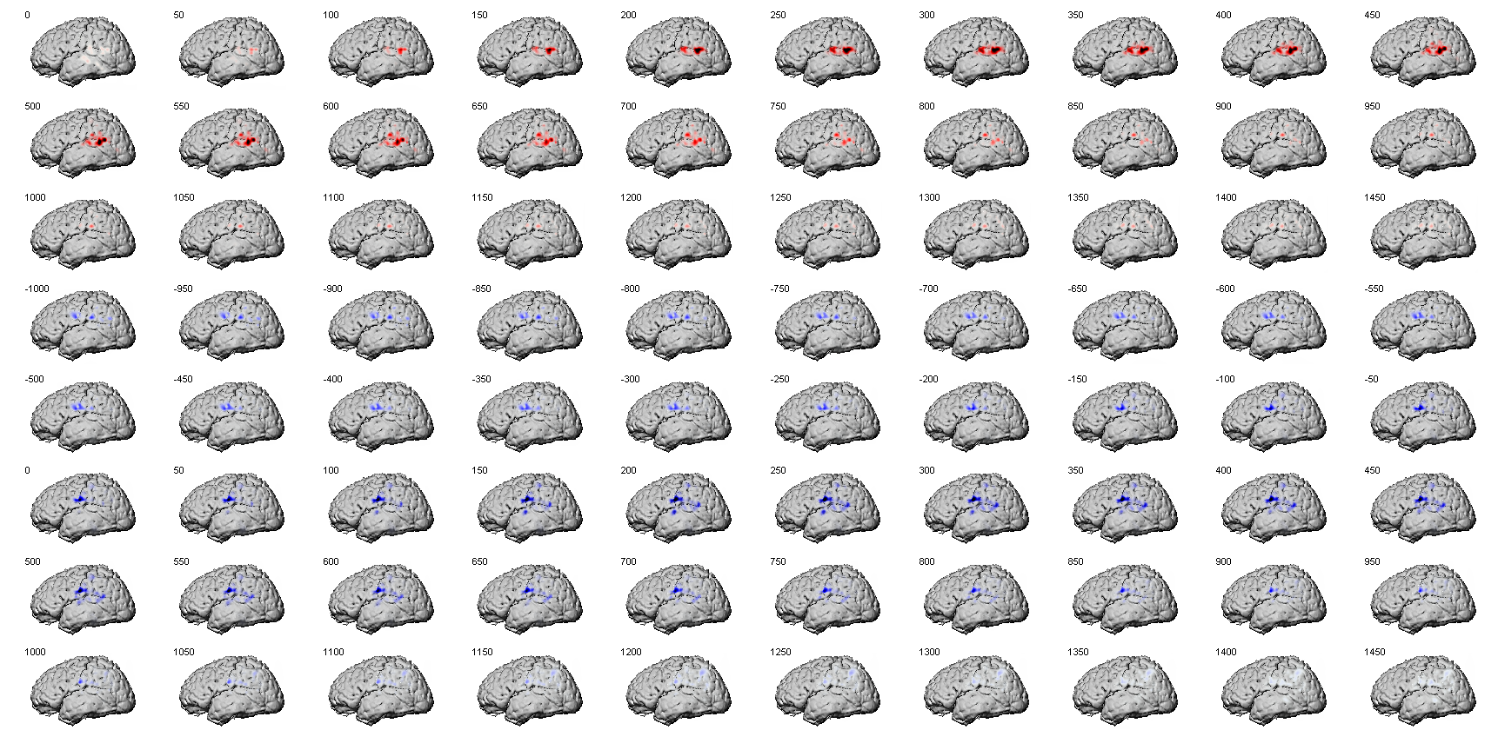
8
Perc
Prod

